Slide 1

Reimagining Archival Access Systems
at the Princeton University Library
Regine Heberlein, Princeton University
Notes:
Hello, my name is Regine Heberlein. I’m an archivist in the manuscripts division at Princeton University, and I’m a member of the group who worked on re-imagining Princeton’s finding aids website. I’m going to talk a little bit about our general goals and some of the archival principles that informed our work, before Shaun and Jon delve into the technical details.
About a year ago, the Archival Description Committee at Princeton University embarked on a re-design of the library’s finding aids website. The committee is chaired by Dan Santamaria, Princeton’s Assistant University Archivist for Technical Services, and includes Jon Stroop and Shaun Ellis from Library Systems as well as Don Thornbury, John Delaney, Maureen Callahan, and myself from the Department of Rare Books and Special Collections.

Slide 2

http://findingaids.princeton.edu/collections/C0001.pdf
Notes:
For those of you who aren't familiar with finding aids, they are descriptive documents created by repositories to provide information about archival collections. They typically provide information about the intellectual organization of a collection, about the nature of the collection as a whole, and about some or all parts of a collection to varying degrees of detail.
In the olden days, i.e. before machine-readable data, finding aids were paper documents such as inventories, indices, guides, or narrative documents that listed the contents of a collection and, ideally, reflected its hierarchical composition. Most of the time, they were either linear documents (lists and narrative documents) or, in some cases, card files. Here is an example of an old-style finding aid rendered in pdf.

Slide 3

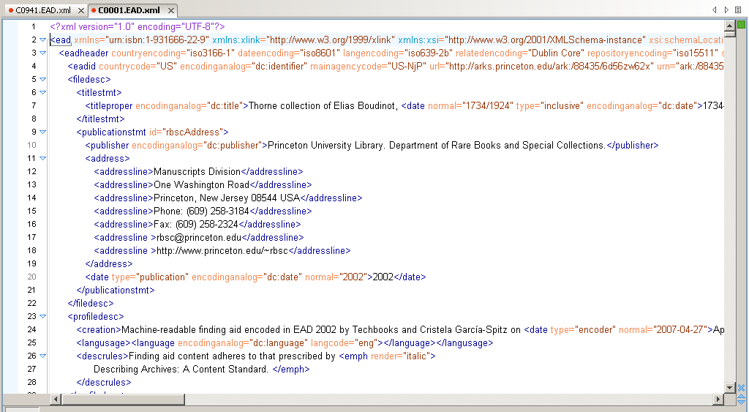
Notes:
At Princeton, we’ve been using Encoded Archival Description (EAD) for encoding our finding aids since 2004, when Dan Santamaria (the chair of our group) started a comprehensive program at Princeton’s Mudd Manuscript Library.
Most of you will be familiar with EAD, but for those who aren’t, EAD is an XML standard for describing archival resources, designed to facilitate the standardization and transmission of finding aid information within and across archival repositories. EAD was conceived by Daniel Pitti in the 1990s and is now being maintained by the Technical Subcommittee for Encoded Archival Description at the Society of American Archivists. It consists of header information, which contains the “front matter”, i.e. information about the creation of the EAD itself, and the actual archival description. The archival description portion proceeds hierarchically from top-level description (the entire collection or even a group of collections) to the lowest level of description (an item or even part of an item within the collection). Top-level information is inherited by lower-level units.
By ways of an example, here is the EAD markup of the same finding aid we just looked at.

Slide 4
Notes:
EAD finding aids are typically rendered as html or pdf pages, both of which are usually fairly static and tend to start with collection-level information and proceed down the hierarchy all the way to the last item. In that sense, they merely emulate the linear finding aid format in electronic form.
Finding aids, even EAD finding aids, can also be fairly redundant. For example, they tend to include certain elements that repeat in a number of finding aids, such as, for example, information about the owning repository (which would be the same for all the collections of a repository) or biographical information about the creator of the collection (which repeats from collection to collection if the creator is the same).
For example, the repository information I’ve circled here applies to some 1500 collections in my division, and is repeated verbatim in every one of those 1500 EAD records. The bit about the descriptive rules below is even worse: it is repeated across all of Princeton’s 2400 EAD finding aids. Biographical notes, too, are repeated; for example, we have seven collections relating to John Foster Dulles, and each of the EADs describing them has its own biographical note.

Slide 5

Persons / Corporate Bodies / Families Description (EAC-CPF)
Record Description (EAD)
Function Description (EAC-F)
Notes:
Our group’s objective was to find improved ways to deliver descriptive data by breaking with linear and redundant finding aid display and instead taking a data-centric and modular approach. For redundant boilerplate information such as repository information and descriptive rules, we’ve moved (and continue to move) towards @id attributes instead of hard-coding repetitive information.
In addition, we decided to store different bits of information in different types of documents. Daniel Pitti has advocated a model in which information about records, information about people and organizations, and information about the functions that people and organizations fulfill over time, is stored in three separate modules, like so. While Encoded Archival Context-Functions is still under development, EAD itself and Encoded Archival Context-Corporate Bodies, Persons, and Families are both SAA standards, and we expect EAC-F to follow suit.

Slide 6
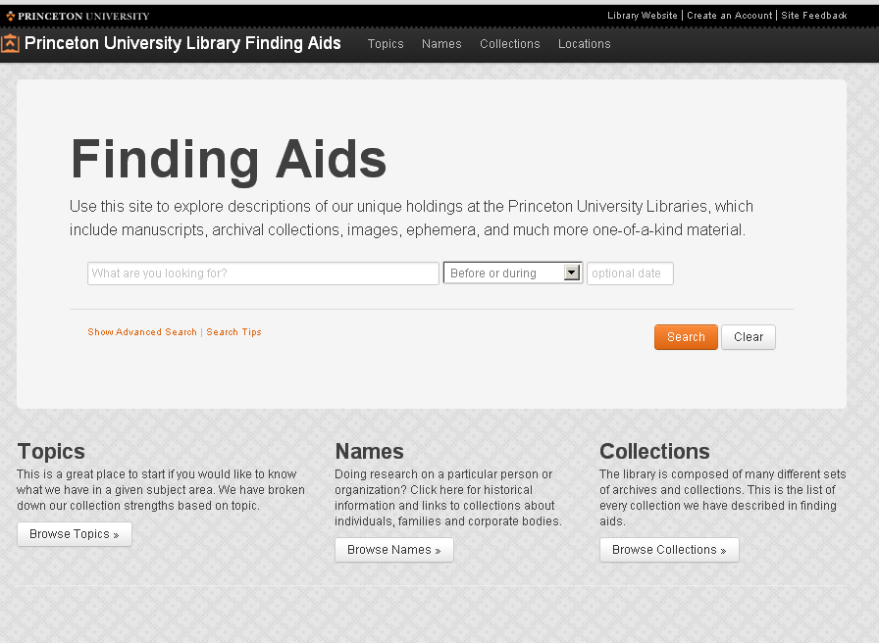
Notes:
One of our goals was to support EAC-CPF, both in order to eliminate the redundancy of repeated biographical notes and in order to allow users to start their research with a person or organization of interest and then find archival material relating to their research directly from that authority record. In addition, we wanted to allow users to sort and filter content, download digital content directly from the finding aid, and be able to augment the finding aid with their own observations.
Following an aggressive timeline, the group conducted usability studies, developed wire frames and mockups, and executed a substantial clean-up and data enhancement project.
We released the new site in September. The main portal offers a simple search box with an optional date filter and three browse modules (collections, for EAD records; names, for CPF records; and topics, which represent our collection strengths).

Slide 7
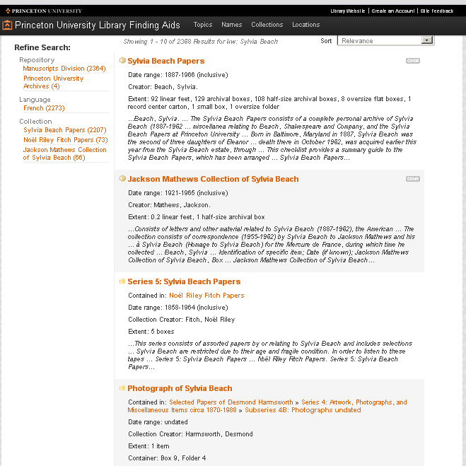
collection
collection
series
file
Notes:
Search results include components of any level rather than, as on our old site, only collection-level records.
This is a significant improvement over the old site, where you would get a result list of collections containing your search term *somewhere*, but you wouldn’t know where or at what level of description, so in order to find out, you’d have to click your way through each collection and do a new ctrl-f search within each. (As cumbersome as this was for me to say it, believe me it was even more cumbersome to have to do it!)

Slide 8
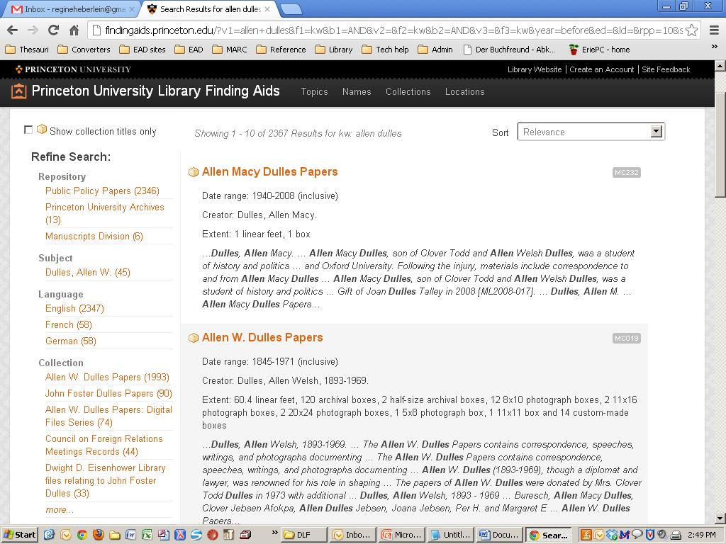
facets
Notes:
Users have two options for refining their results: they may use the facets on the left to filter, for example, by repository, language, subject, or to limit their results to collection-level records…

Slide 9
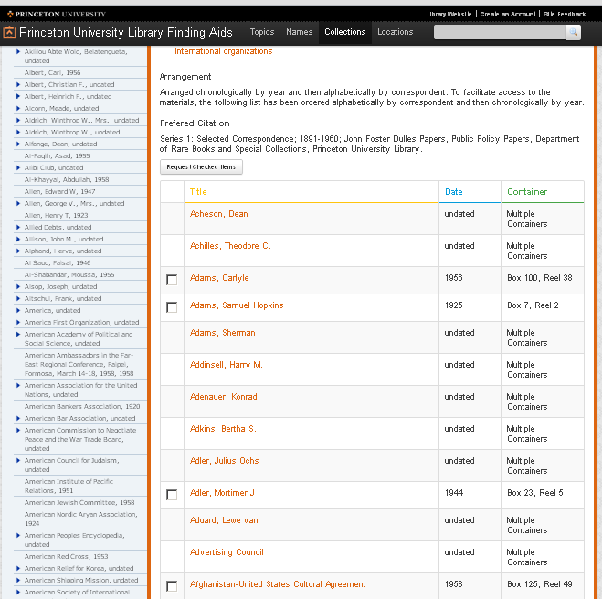



sort
Notes:
…or they may sort their results in the component view. Results can be sorted alphabetically by title, chronologically by date, or sequentially by container.

Slide 10
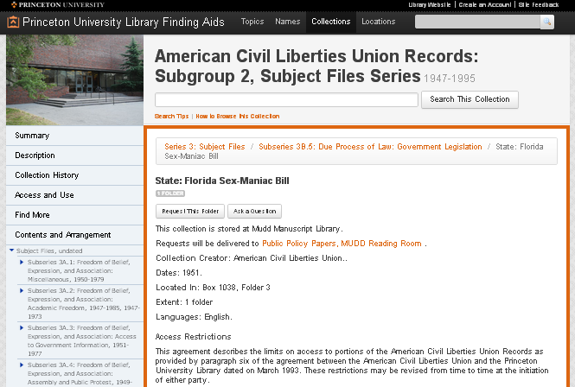

Aeon request
Reference question
…
Notes:
The component-level records are designed as stand-alone descriptive records. Each component meets single-level minimum requirements for DACS, the archival content standard, which means it has a unique identifier, a title, a date, an extent statement, names the creator, and contains notes describing the scope and content, the conditions governing access, the language of the material, and the name and location of the repository. In addition, each component has a stable URL.
A number of computations enrich the component-level data by displaying inherited contextual data, calculating the extent of the material, and normalizing dates.
The site is fully integrated with the Aeon request system, which Princeton implemented in April, allowing users to request material at any level of description directly from the finding aid.
Each record also includes a button for asking a reference question, which sends a message directly to public services staff. The message automatically identifies the component the question is being asked about.
This series-level record (about the Florida Sex-Maniac Bill) was too long to display here as a whole, but if I scroll to the bottom…

Slide 11
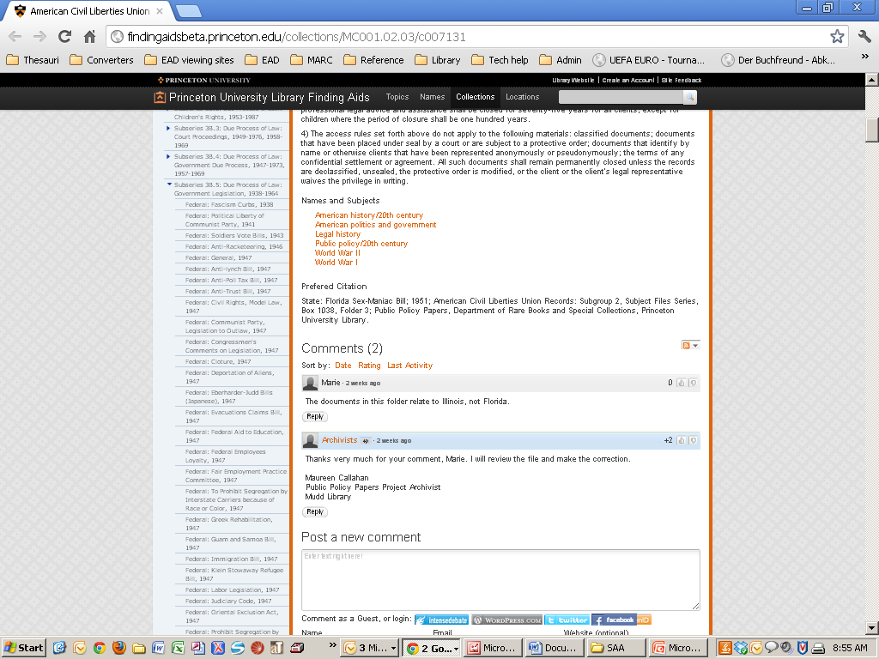
…
Comment
Notes:
…you see that each record also includes a comment box to allow for user-contributed content. Comments are moderated by staff in IntenseDebate. Users may also "push" their comments to their own social networks such as Twitter and Facebook.
As you see here, a user alerted us to the fact that the Florida Sex-Maniac Bill material actually relates to Illinois.

Slide 12
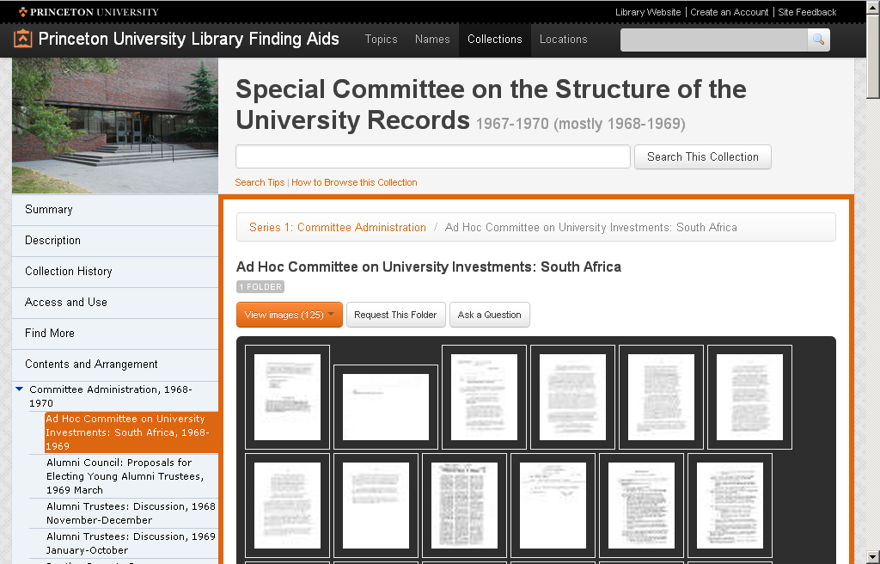
Notes:
Finally, each component-level record offers direct access to digital objects, when available.
If digital objects are available, a “View Images” button displays with a count of the available objects . Users may browse thumbnails as shown here, open a page viewer to browse in full view, or download all digital objects at once in a combined PDF document.
We hope this infrastructure will allow us to develop a full-scale digitization-on-demand program and will pave the way for the effective delivery of born-digital content.

Slide 13
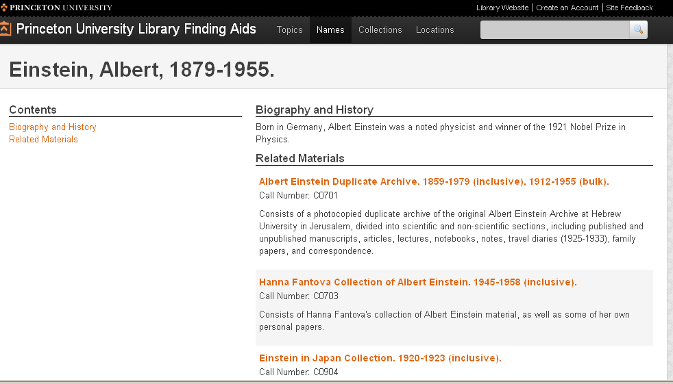
Notes:
Our next project is to integrate CPF records. At the moment, we have a few hand-encoded CPF records on the site, but we’re working with Daniel Pitti’s Social Networks and Archival Context (SNAC) project (a large-scale project to create and merge archival authority records across repositories) on the automated extraction of the CPF records from our EADs. Daniel Pitti, meanwhile, is working to transform the SNAC project, which is hosted at the University of Virginia, into a National Archival Authorities Cooperative (NAAC) with NARA, so eventually we hope to contribute our archival authority records to a national repository.
We're also hoping to deliver our almost 800,000 EAD components as stand-alone records in Primo, the University Library’s new discovery system, using similar concepts.

Slide 14
Questions?
heberlei@princeton.edu
findingaids.princeton.edu
Notes:
We’ve been gathering GoogleAnalytics data to identify search and request patterns on the new site and from Aeon, which we hope will help us refine our access systems in the future. Please stay tuned.
Check out our site if you’re interested, at findingaids.princeton.edu. We're always happy to hear comments and questions, so please do get in touch.

